Slide 1
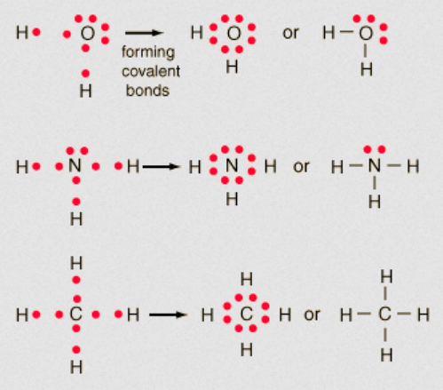
Lewis structures of covalent molecular substances

Slide 2
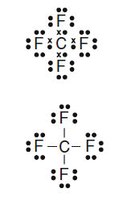
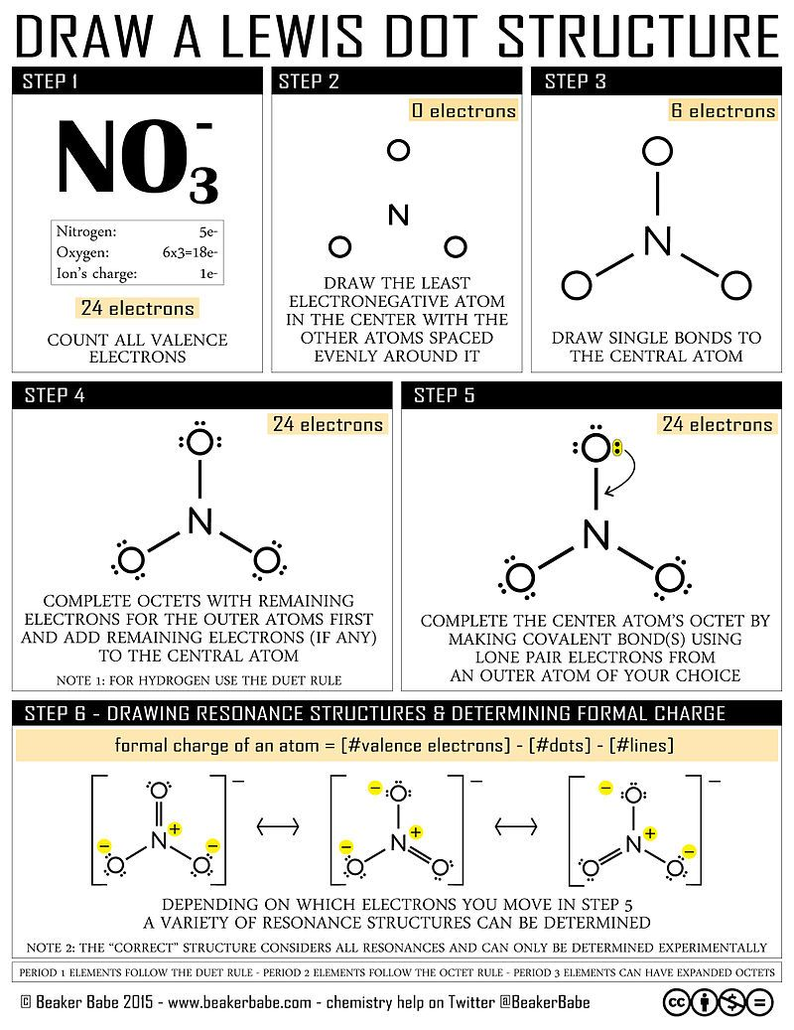
Steps for drawing Lewis structures

Slide 3
Steps for drawing Lewis structures
Let us work through the steps using an examples – draw the Lewis structure for water
Step 1) count all valence electrons: H₂O
2 x (hydrogen 1 e-)
oxygen 6 e-
ion charge 0 (water is neutral)
total = (2 x 1) + 6 + 0 = 8 valence electrons

Slide 4
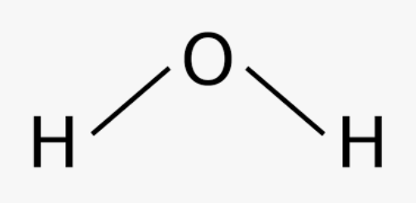
Steps for drawing Lewis structures
Step 2 and 3: draw the Skelton structure of the molecule by connecting the atoms with single bonds (2 electrons per bond). Generally, the central atom is the least electronegative atom BUT hydrogen is often attached to oxygen.
Electron count: 2 bonds = 2 x 2 e- = 4 electrons

Slide 5
Steps for drawing Lewis structures
Step 4: add in the remaining octet electrons. Hydrogen need 2 electrons – check both have 2 electrons
Oxygen needs 8 electrons – currently has 4 electrons so we need to add in 4 e- (2 lone pairs)
Electron count: 2 bonds = 2 x 2 e- = 4 electrons
2 lone pairs = 2 x 2 e- = 4 electrons
total = 8 e- (matches step 1)

Slide 6
Steps for drawing Lewis structures
We stop here as all electrons have been accounted for

Slide 7
Steps for drawing Lewis structures
Try a harder one: HNO₃ (nitric acid)
H
O
N
O
Hydrogen 1 electron
nitrogen 5 electrons
oxygen 3 x 6 electrons
Molecule charge 0
Total = 1 + 5 + (3 x 6) + 0 = 24 e-
I added 16 electron dots. Hydrogen – full, all oxygens – full but nitrogen is short it only has 6 electrons
O
Have 16 e- left add them to outer atoms first.
Hydrogen – full already (2 e-)
H
O
N
O
H
O
N
O
I need to add a double bond to the oxygen (one without the hydrogen)
Nitrogen = 8 e- now as well
O
O
Nitrogen in middle – lowest EN
Hydrogen attached to oxygen
Electrons used so far = 4 x 2 e- = 8 e-
Have 16 e- left add them to outer atoms first.
Hydrogen – full already (2 e-)

Slide 8
Steps for drawing Lewis structures
Drawing Lewis structure for polyatomic ions uses the same procedure – except that in the molecule charge you include the charge.
Be careful!
Anion e.g. CO₃²⁻
Cation e.g. NH₄⁺
Is negative so it has extra electron – so electrons due to molecular charge = + 2 e-
Is positive so it has less electron – so electrons due to molecular charge = - 1 e-

Slide 9
Naming covalent molecular substances
There are many naming schemes for covalent molecular substances, such as names for acids, hydrocarbons and simple binary molecules
You will need to learn the names of common substances from appendix 2
You will learn about naming schemes for hydrocarbons when we start Organic Chemistry
Going to now go through the steps for naming simple binary covalent molecules (molecules with only two types of atoms)

Slide 10

Naming covalent molecular substances
Example 1: CO₂
Step 1: carbon
Step 2: oxide
Step 3: carbon dioxide
Step 4: don’t need the “mono” in front of carbon as it is assumed

Slide 11
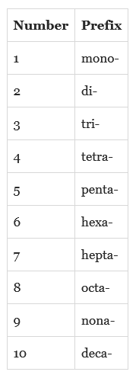
Naming covalent molecular substances
Great video if you need more help:
https://www.youtube.com/watch?v=DejkvR4pvRw
Prefixes you will need to know for this and later for Organic chemistry

Slide 12
Steps for drawing Lewis structures
Best way to learn drawing Lewis structures for covalent molecules is to practice.
Complete the worksheets and do STAWA Set 17
You should also be working on Completing Pearson Chapter 6 section and chapter review and STAWA Set 13 and 14

